Slide 1
AI ACTIVE LEARNING
VEHICLE DETAILS RETRIEVAL
Group: 8
PB 27 Simran Vaishya
PB 29 Tushar Birari
PB 43 Adarsh Malviya
PB 51 Disha Bajaj

Slide 2
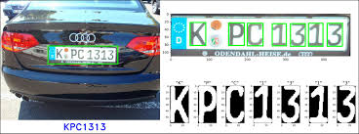
PROBLEM STATEMENT
Traffic Law Violation detection by creating CNN Model or Deep Learning Model which can detect Vehicle’s Number Plate characters that will get the owner’s information using Python and Flask API.

Slide 3
INTRODUCTION
Vehicle Plate Number Recognition (VPNR) system which is a real-time embedded system to automatically recognize license plate numbers.
The main aim of the system is to use image processing to identify vehicles violating traffic by their plate numbers.
The image captured is processed to extract the numbers on the image. The numbers on the capture images can be viewed on a web page via an IP address.
The system if implemented can be used to improve road safety and control traffic of emerging smart cities.

Slide 4
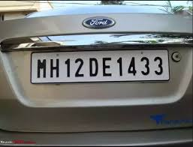
DATASET
• Dataset has been downloaded from https://www.kaggle.com/andrewmvd/car-plate-detection.
This dataset contains 433 images with bounding box annotations of the car license plates within the image.

Slide 5
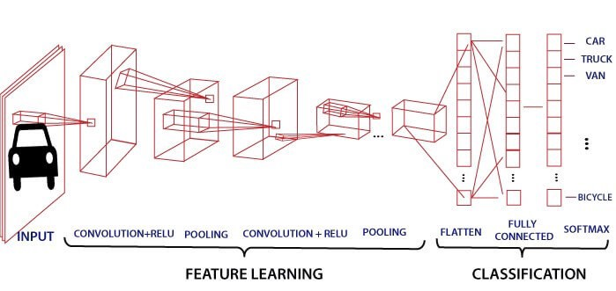
CNN ARCHITECTURE

Slide 6
METHODOLOGY
VEHICLE’S NUMBER PLATE DETECTION
PRE-PROCESSING IMAGE
SEGMENTATION OF IMAGE
TRAINING MODEL
GETTING VEHICLE’S INFO
Detecting the number plate from the vehicle images and make a green rectangle boundary around the number plate.
Convert the image into grayscale and display the number plate.
Partitioning the image into multiple segments to analyze the digit in a simpler way.
Creating the CNN model and training it to find out the model accuracy
Test the model using API to get the vehicle’s information

Slide 7
APPLICATIONS
FIND STOLEN CAR
TOLL
PARKING
ACCESS CONTROL
This kind of system can be deployed on the roadside and makes a real-time comparison between passing cars and the list of stolen cars.
The car number is used to calculate travel costs on a toll road, or used to re-check tickets
The license plate number is used in car parks to calculate parking fees by comparing entry and exit times
The automatic opening of a door for authorized members in a safety zone. This kind of system is set up to help security officers.

Slide 8
FETCHING VEHICLE DETAILS USING API
In this part of the project vehicle details are fetched using the plate number retrieved.
The details are fetched using an API provided by http://www.regcheck.org.uk/.
http://www.regcheck.org.uk/ is a website which provides vehicle details lookups using plate numbers of vehicle from various countries.
The process followed is:
After the plate number is retrieved, a request is sent to the API with the plate number and the username.
The API will respond with XML data. Which will be parsed into dictionary.
Then, the data will be converted into JSON and the useful data will be extracted using the keys

Slide 9
CONCLUSION
This project presents a recognition method in which the vehicle plate image is obtained by the image of the vehicle provided and the image is then processed to get the number plate information. Then, the vehicle number retrieved and is used to get the owner and the vehicle details using an API.

Slide 10


